Slide 1
Introduction
Mobile devices prices are constantly on the rise and the reason for this has been said to be due to the increase in the level of technology and specification the device has, but some says like many other consumer items the brand of the device also plays a part in the deciding price of the devices. To find out if the brand of the devices influences the final price, dataset on device released from 2014 to 2017 will be looked

Slide 2
Data Collection The data set used for this investigation was extracted from GSM Arena, one of the most popular online providers of mobile device information and holds a large collection of device specifications. This dataset was scraped and posted on Kaggle.com by Arwin Neil Baichoo and contain the following variable that will be analysed using Microsoft excel The data cleaning was difficult as multiple columns had multiple sub-values with the main value together, and deciding how much information to keep for each variable and how they will affect the final analysis was important
Variable | Type | Comments
Brand | Categorical - Nominal | Independent
Model | Categorical - Nominal | ID-No analysis possible
Year Announced | Categorical - Nominal | Independent
Display_type | Categorical - Nominal | Independent
Display_size | Categorical - Nominal | Independent
Operating_Software | Categorical - Nominal | Independent
internal_memory | Numerical - Discrete | Independent
RAM | Numerical - Discrete | Independent
primary_camera | Categorical - Nominal | Independent
loud_speaker | Categorical - Nominal | Independent
bluetooth | Categorical - Nominal | Independent
USB | Categorical - Nominal | Independent
Price_EUR | Numerical - Continuous | Response Variable (Dependent)

Slide 3
The first variable that was investigated was the price of the device’s vs the brand. In Table 1. The popular brands have such as Samsung and Apple the have phone as high priced as 900 but where not the most expensive devices, Vertu brand devices where priced as low as 2330 euro.
Brand | Number_of Device | Cheapest_Device | Most_Expencive_Device
Vertu | 9 | 2330 | 9000
Huawei | 209 | 30 | 1400
Sagem | 6 | 140 | 1200
Gionee | 54 | 60 | 1150
Nokia | 294 | 30 | 1070
Asus | 119 | 70 | 1000
Apple | 35 | 90 | 900
Panasonic | 46 | 70 | 900
Samsung | 786 | 30 | 900
Vertu | 9 | 2330 | 9000
Huawei | 209 | 30 | 1400
Sagem | 6 | 140 | 1200
Gionee | 54 | 60 | 1150
Nokia | 294 | 30 | 1070
Asus | 119 | 70 | 1000
Table 1. Table of the most common brand of mobile devices and their prices

Slide 4
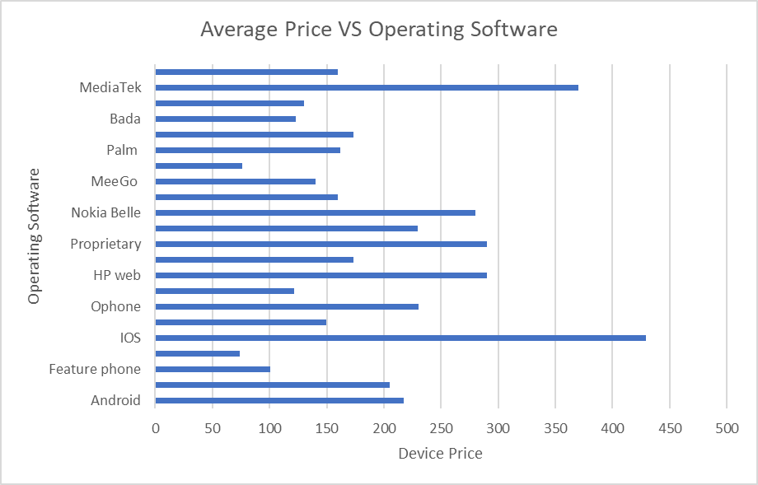
The operating software (OS) chosen can increase the chance of sale and price the devices. The two OS that their devices was had a high average price was IOS followed by MediaTek even though Android was the most used OS.

Slide 5
The year the phone was released was also looked at and a trend was seen from 2010 where the average price for devices increases every year with 2017 having the average price of 297 even though the number of devices released was lower compared to previous years. This can be seen in Graph 2. and Graph 3. bellow

Slide 6
Graph 3. Number of devices from each year

Slide 7
The factor that makes a major impact on the devices price was the display, as it the most expensive components in the manufacturing. Devices with a Sapphire crystal display where highly priced compared to the other display. This display are used in devices made by Vertu. The most used display are:
Table 2. Devices Display comparison
Display type | No. of device with display type | MIN_price | MAX_Price
Sapphire crystal | 5 | 5000 | 9000
TFT capacitive | 912 | 10 | 800
TFT | 981 | 10 | 6140
IPS LCD | 1216 | 50 | 770

Slide 8
Conclusion and prospective future work
The factors that influence a mobile device price varies but the most deciding factor was the display use and OS. Brand also influence the price but not as much as the other factors.
If further studies was done the total sale and the region of sale will be investigated in the case his has an effect on the pricing of each Brand

Slide 9
Difficulties
As this dataset was scraped from a website the information and the state of the data depends on the website itself and the scraping method,
This affected the final analysis as some of the variables that were to be looked at required information to be looked up manually entered into the spreadsheet, This was avoided as much as possible not to add additional errors.
The conversion of different value units made some variables ununiformed and hard to use in the investigation

